Slide 1
Web & Network Security: Web Infrastructure CS-4440 - Introduction to Computer Security Spring 2022 Jun Xu Slides adapted from Chamnap Chhorn at Yoolk

Slide 2
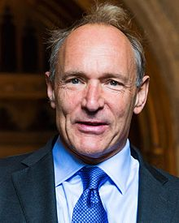
The World Wide Web (WWW)
in 1989, Tim Berners-Lee suggested a way to let all users, particularly scientists, browse each others' papers on the Internet;
He developed HTML, URLs, and HTTP

Slide 3
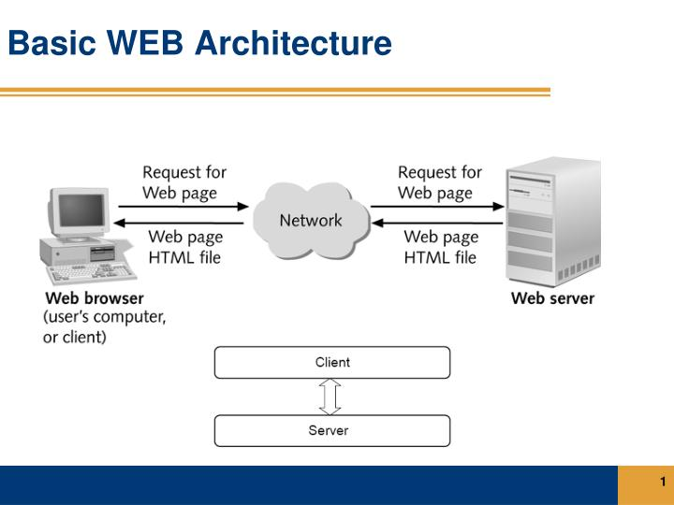
Web Architecture

Slide 4
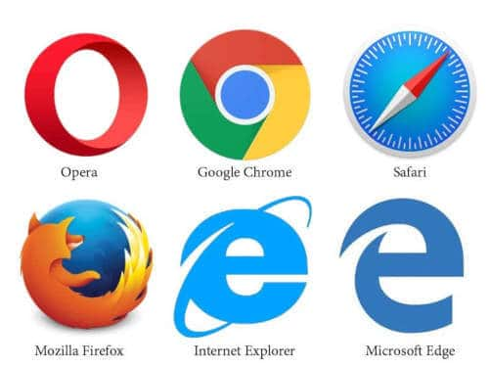
Web Browsers
An application for retrieving, presenting, and traversing information resources
The primary purpose is to bring information resources to the user and get inputs from the users

Slide 5


Web Servers
A computer program that accepts HTTP requests and return HTTP responses with optional data content
A computer/machine that runs a web server program

Slide 6
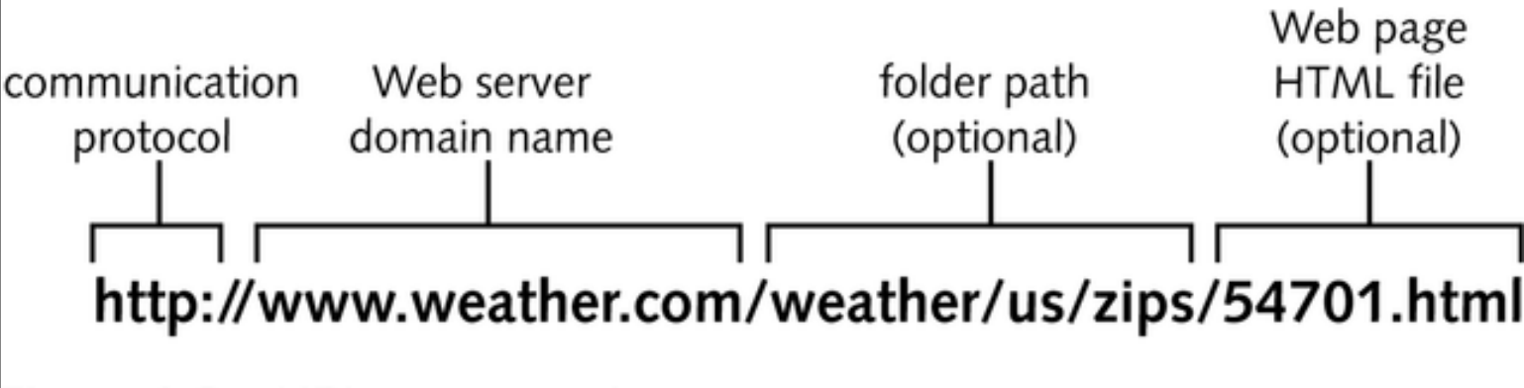
Universal Resource Identifier (URI)
URLs are location dependent
It contains four distinct parts: the protocol type, the machine name, the directory path, and the file name.
There are several kinds of URLs: file URLs, FTP URLs, and HTTP URLs.

Slide 7
Hypertext Transfer Protocol (HTTP)
HTTP is an application-level protocol for distributed, collaborative, hypermedia information systems.
HTTP is a request/response standard of a client and a server.
Typically, an HTTP client initiates a request.
Resources to be accessed by HTTP are identified using Uniform Resource Identifiers (URIs).

Slide 8

HTTP: Request Message
The request message consists of the following:
Request line
Headers (Accept-Language, Accept, ….)
An empty line
An optional message body

Slide 9
HTTP: Request Methods
HTTP defines eight methods (sometimes referred to as "verbs") indicating the desired action to be performed on the identified resource.
HEAD
GET
POST
PUT
DELETE
TRACE
OPTIONS
CONNECT

Slide 10
HTTP: Safe Methods
HEAD, GET, OPTIONS and TRACE are defined as safe (no side effects).
POST, PUT and DELETE are intended for actions which may cause side effects on the server.

Slide 11
HTTP: Status Code
The first line of the HTTP response is called the status line.
The way the user agent handles the response primarily depends on the code and secondarily on the response headers.
Success: 2xx
Redirection: 3xx
Client-Side Error: 4xx
Server-Side Error: 5xx

Slide 12
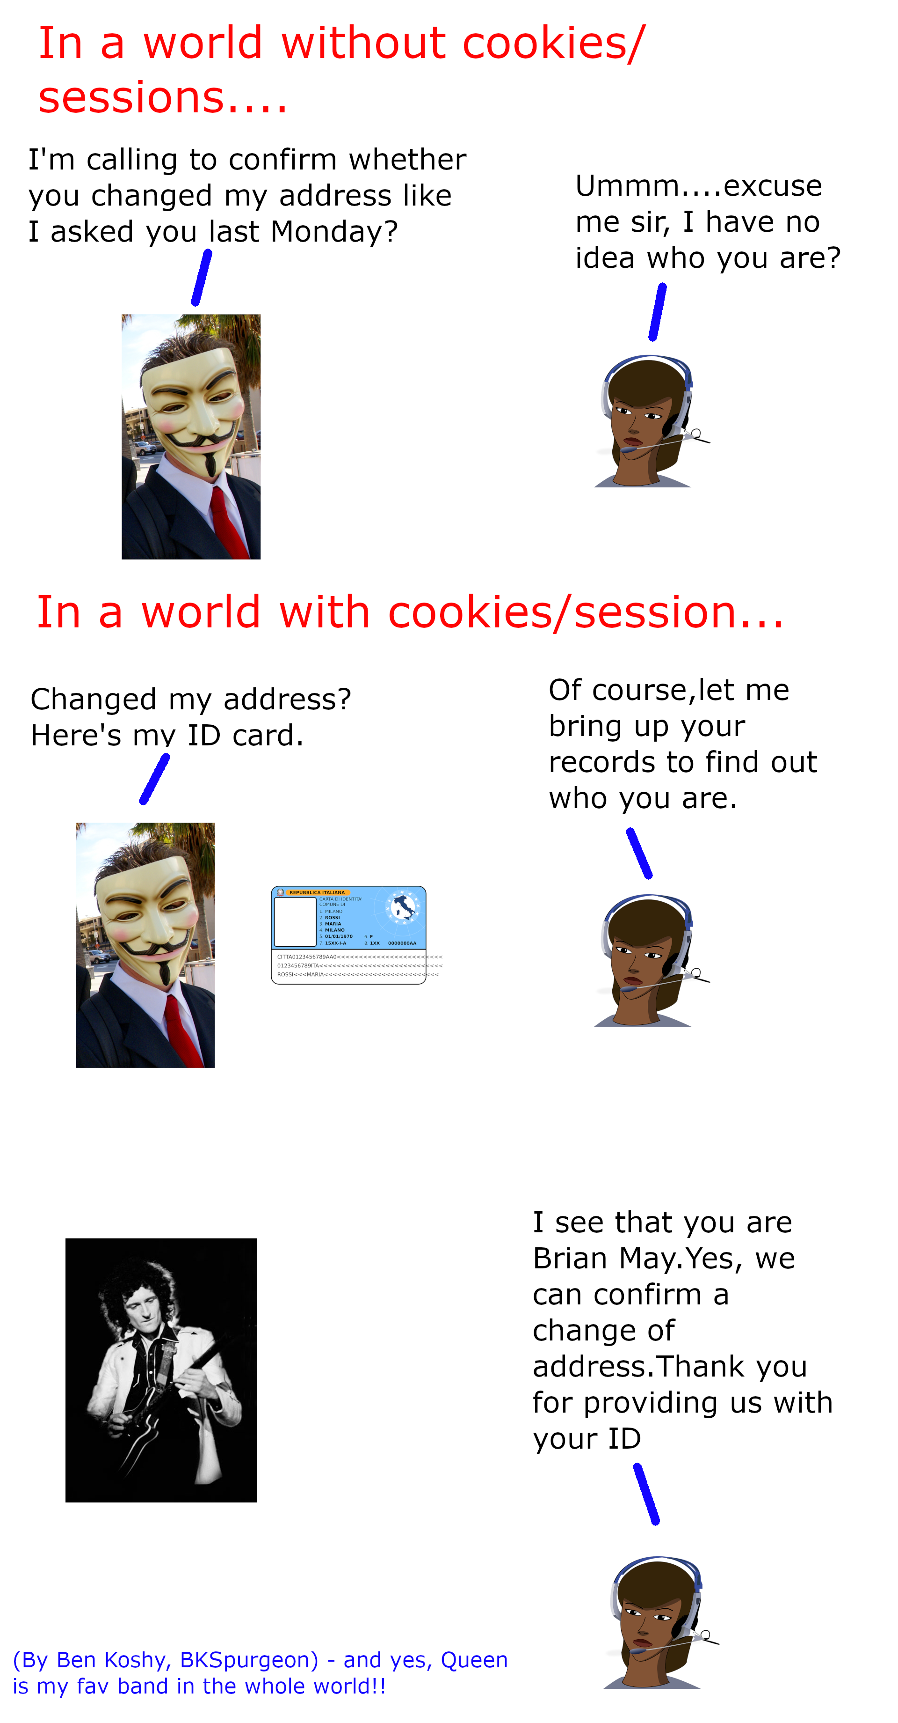
HTTP: Session State
HTTP is a stateless protocol.
Hosts do not need to retain information about users between requests.
Statelessness is a scalability property.
Solution to maintain states:
Cookies
URL encoded parameters (such as /index.php? session_id=some_unique_session_code)

Slide 13
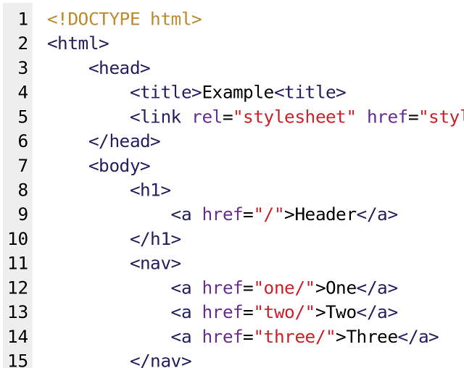
Format of Data: HyperText Markup Language (HTML)
Define structure and contents of web pages

Slide 14
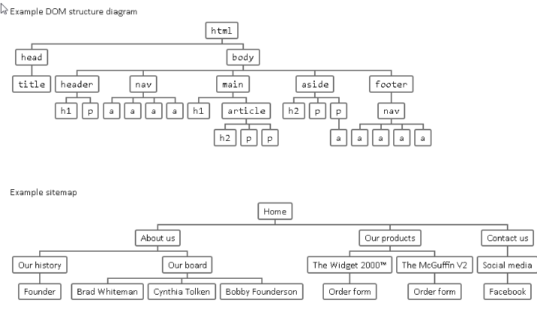
Structure of HTML: DOM Tree

Slide 15
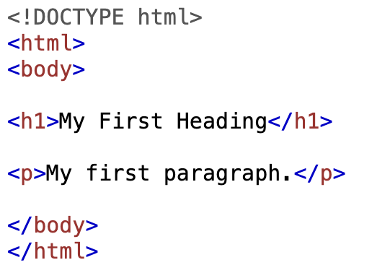
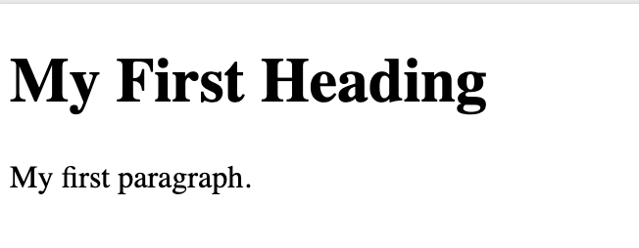
An Example of HTML
https://www.w3schools.com/html/tryit.asp?filename=tryhtml_basic_document
Is HTML a programming language?

Slide 16
Format of Data: Cascading Style Sheets (CSS)
CSS is a style sheet language used for describing the presentation of a document written in a markup language such as HTML.
CSS is designed to enable the separation of presentation and content, including layout, colors, and fonts.
Improve content accessibility; provide more flexibility and control in the specification of presentation characteristics
Enable multiple web pages to share formatting by specifying the relevant CSS in a separate .css file, which reduces complexity and repetition in the structural content;
Enable the .css file to be cached to improve the page load speed between the pages that share the file and its formatting.
No need to read the above texts

Slide 17
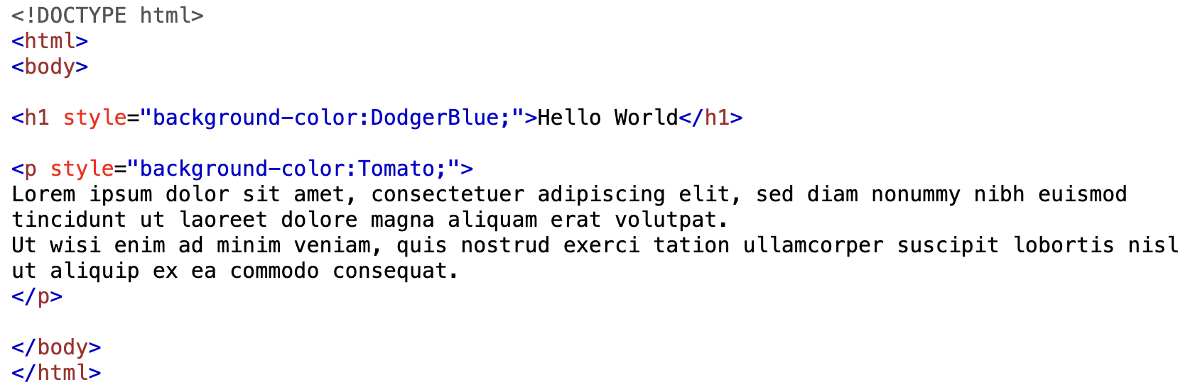
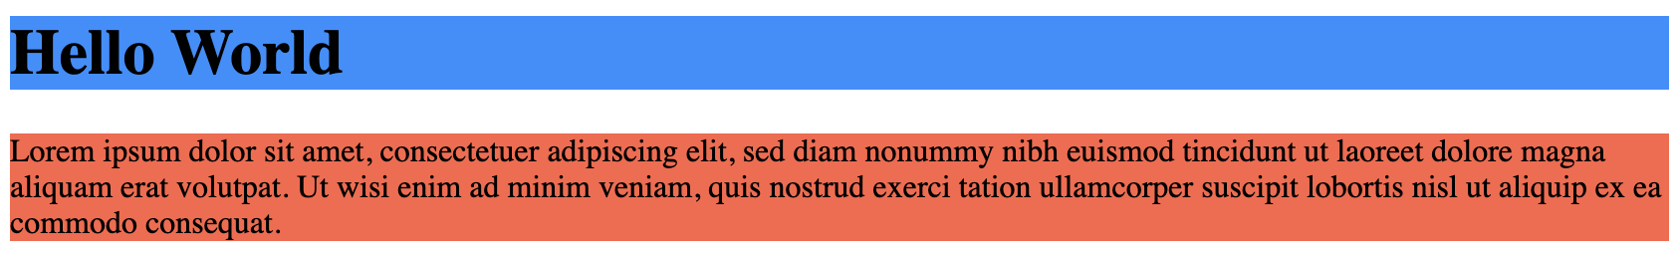
An Example of CSS (internal)

Slide 18
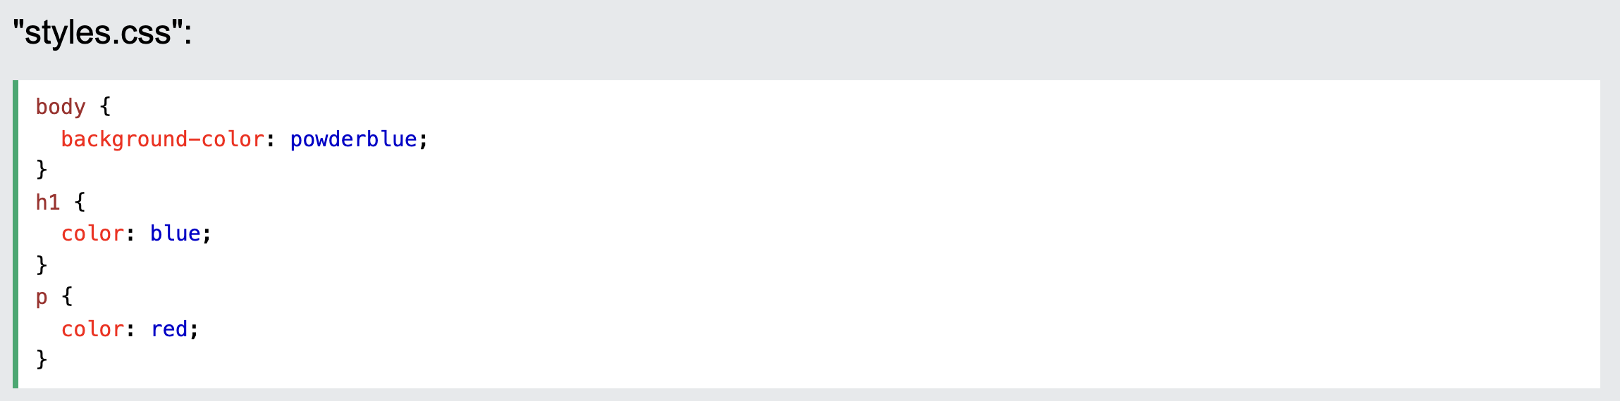
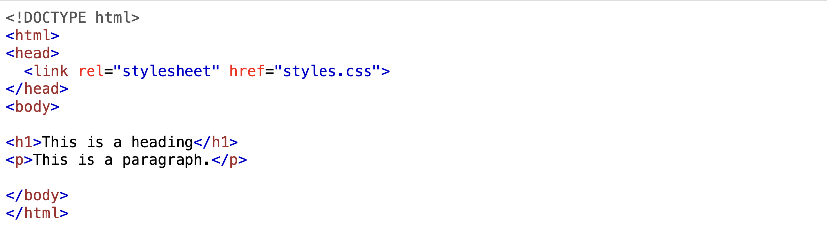
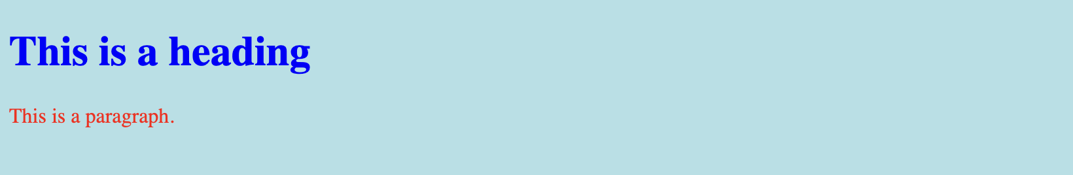
An Example of CSS (external)
CSS
HTML
Webpage

Slide 19
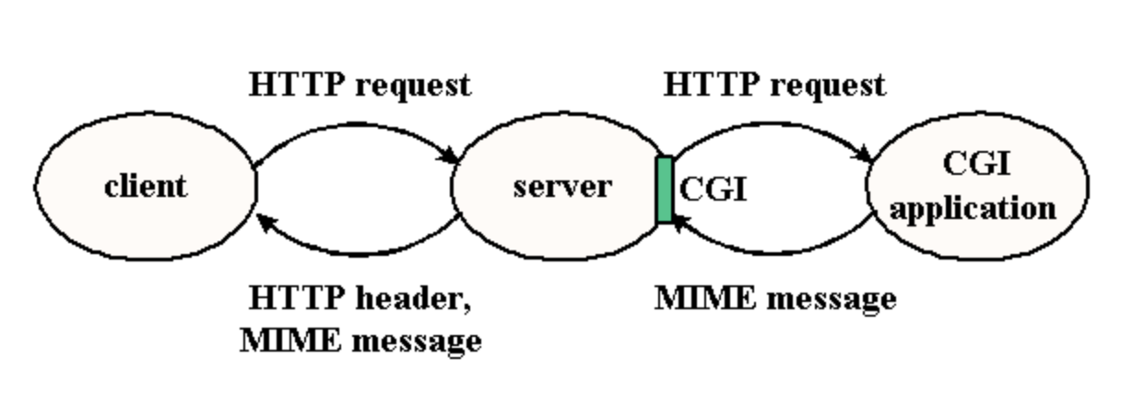
Web Architecture Extension: Dynamic Web Service
This basic web architecture is fast evolving to serve a wider variety of needs beyond static document access and browsing.
Common Gateway Interface (CGI) extends the architecture to three-tiers by adding a back-end server that provides services to the Web serve

Slide 20
Common Gateway Interface (CGI)
CGI is a standard protocol for interfacing external application software with a web server.
CGI programs are executable programs that run on the Web server.
The CGI program typically returns HTML pages that it constructs on the fly.

Slide 21
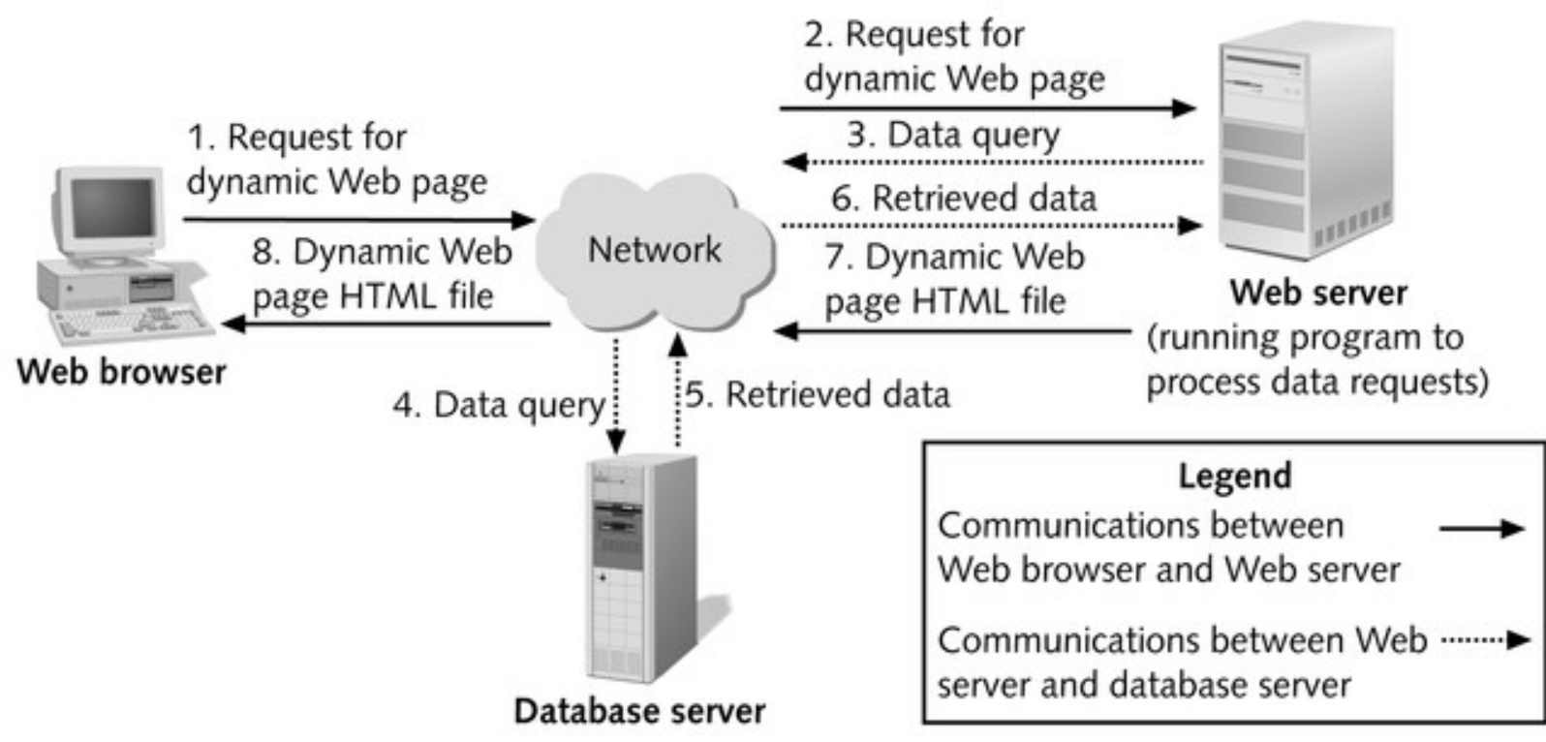
Dataset-driven Website Architecture

Slide 22
Client-side Processing
Client-side processing
Processing needs to be “executed” by the browser, either to form the request for the dynamic Web page or to create or display the dynamic Web page.
E.g., validating user input

Slide 23
Tool for Client: JavaScript
JavaScript is a scripting language designed for creating dynamic, interactive Web applications that link together objects and resources on both clients and servers.
Getting your Web page to respond or react directly to user interaction with form elements and hypertext links
Preprocessing data on the client before submission to a server
Changing content and styles

Slide 24
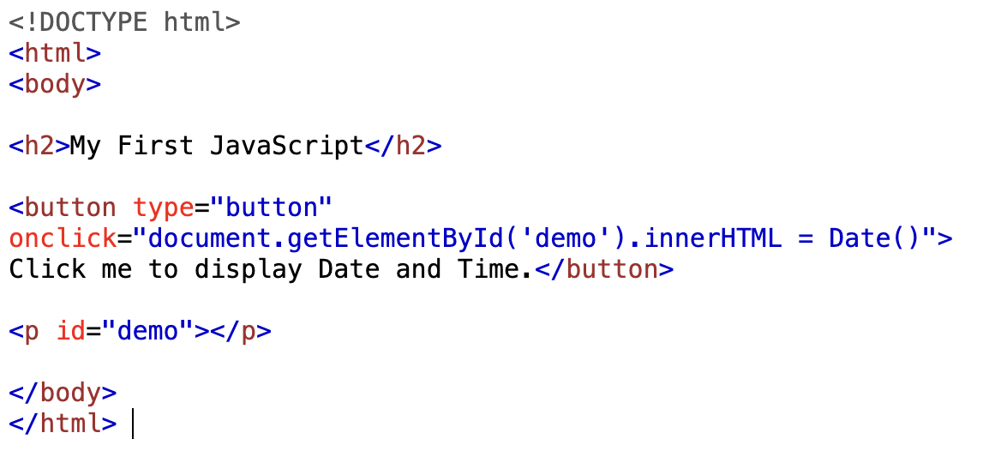
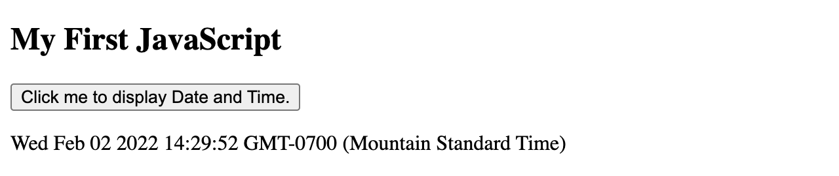
JavaScript Example 1
Where is the JavaScript???

Slide 25
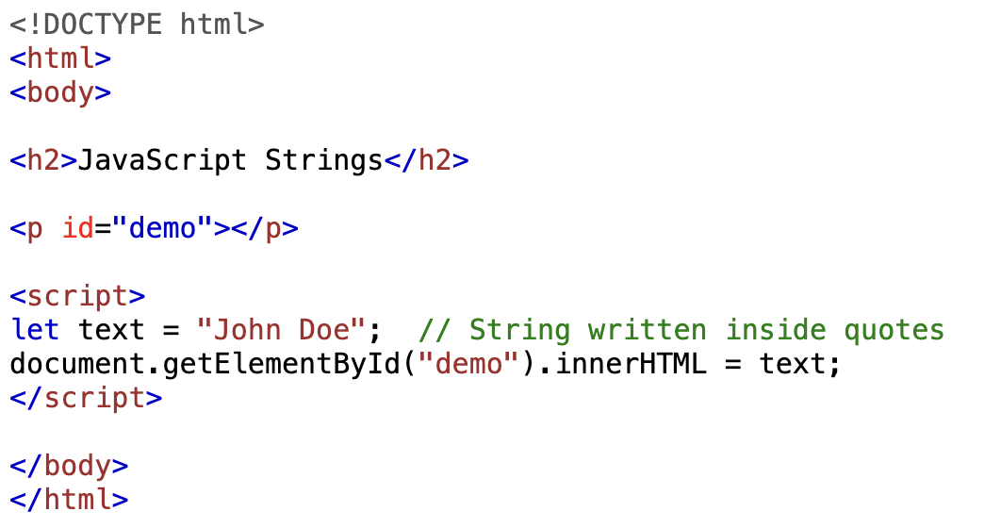
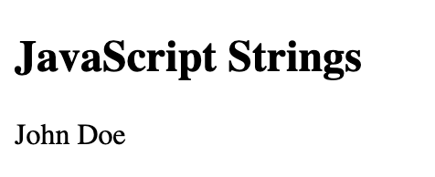
JavaScript Example 2
Where is the JavaScript???

Slide 26
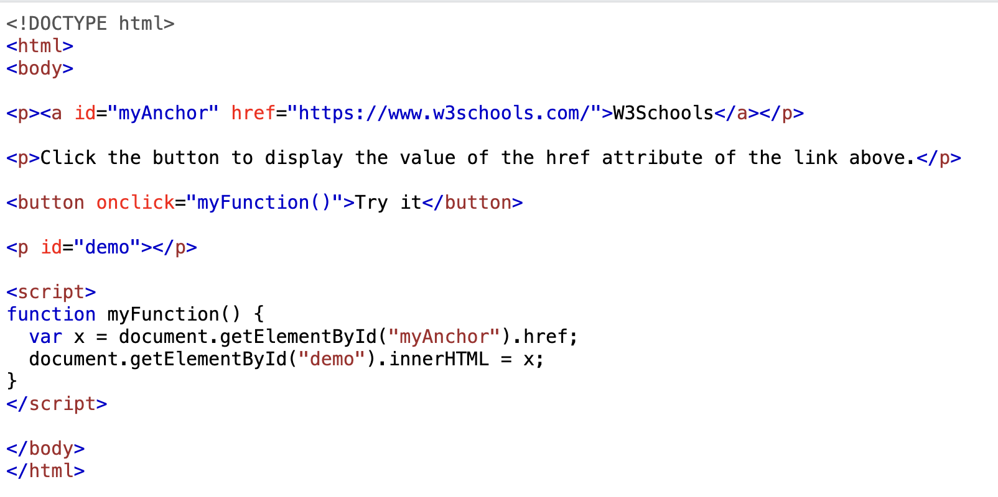
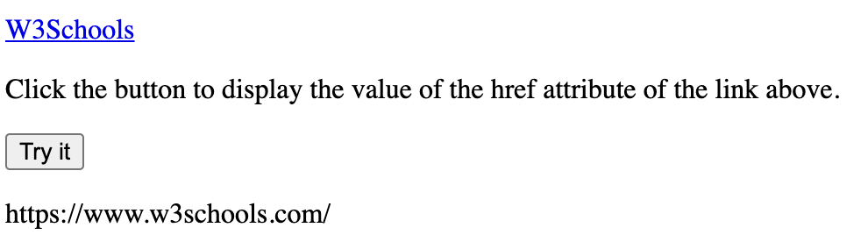
JavaScript Example 3
What is special here???

Slide 27
Server-side Processing
The Web server:
Receives the dynamic Web page request
Performs all the processing necessary to create the dynamic Web page
Sends the finished Web page to the client for display in the client’s browser

Slide 28
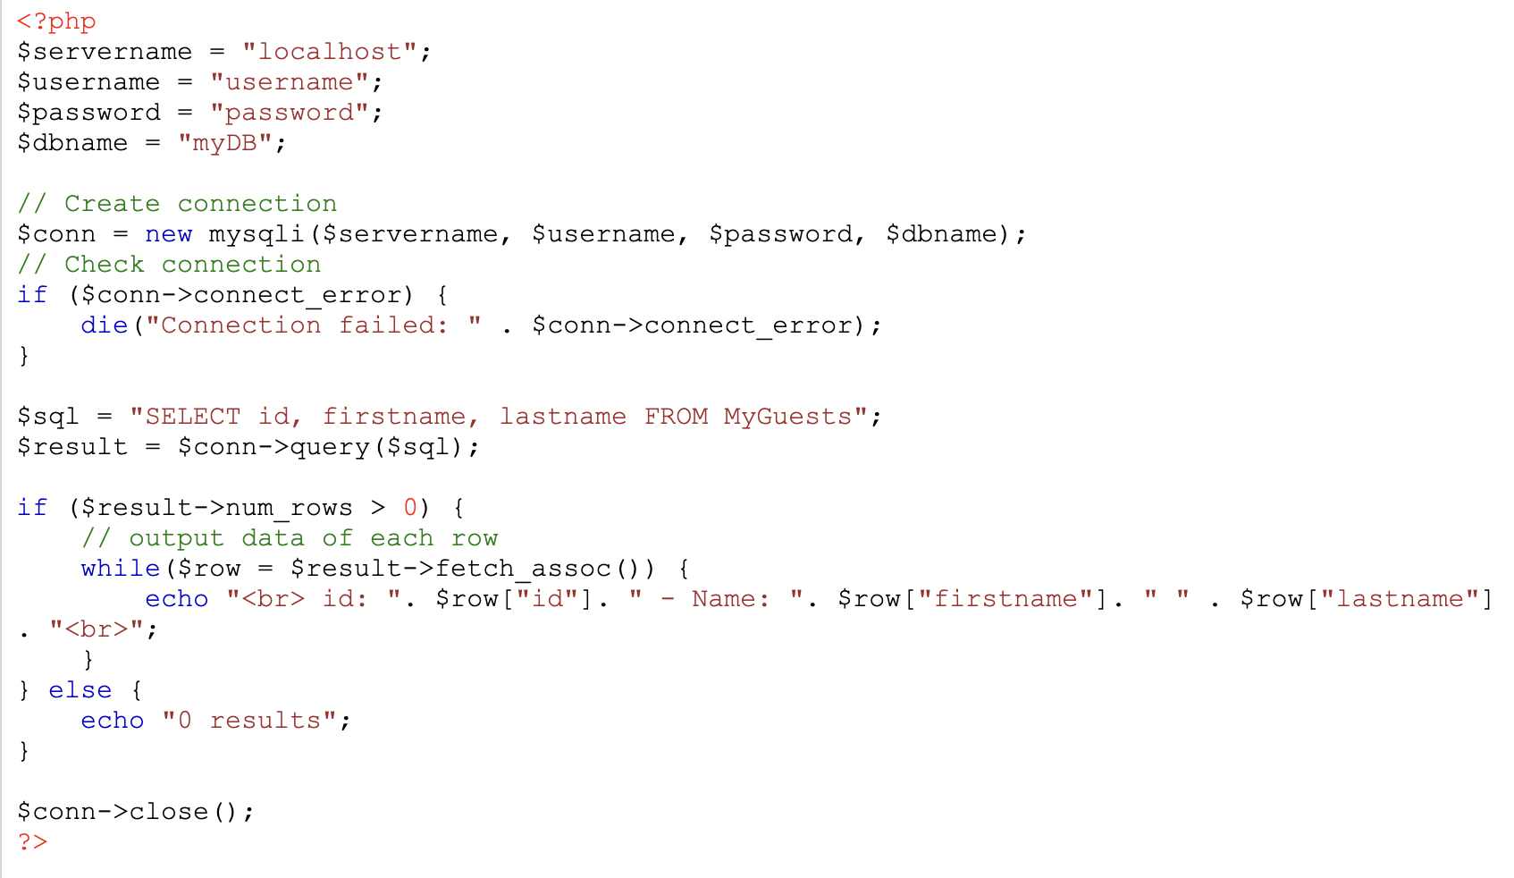
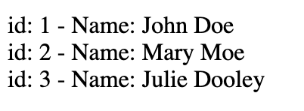
Tools for Server: PHP + SQL (Also Python, NodeJS, …)

Slide 29
Enable Stateful Service: Cookie
Cookie is a small piece of text stored on a user's computer by a web browser.
A cookie consists of one or more name-value pairs containing bits of information such as user preferences.
It is sent as an HTTP header by a web server to a web browser and then sent back unchanged by the browser each time it accesses that server.
A cookie can be used for authenticating, session tracking (state maintenance), and remembering specific information about users.

Slide 30
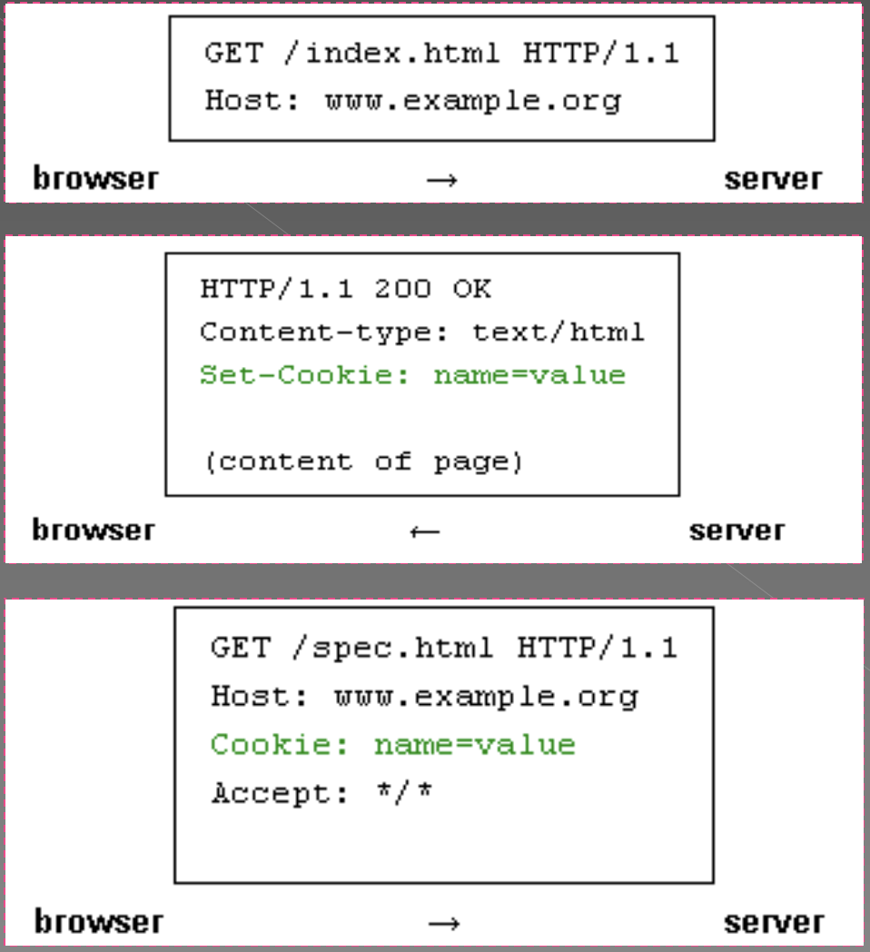
Example of Cookie

Slide 31
Cookie Expiration
Cookies expire, and are therefore not sent by the browser to the server, under any of these conditions:
At the end of the user session (i.e., when the browser is shut down) if the cookie is not persistent
An expiration date has been specified, and has passed
The expiration date of the cookie is changed (by the server or the script) to a date in the past
The browser deletes the cookie by user request

Slide 32
The First Web Security Case
http://www.insecurelabs.org/task/Rule1?query=
What could go wrong here?

